Slide 1



DAIDALUS Analysis Tools
Jason Davies (ARC-AFT)[USRA]
November 13, 2017

Slide 2
Background
Desired an easy-to-use toolchain for working DAIDALUS with flight-test data
MATLAB environment is great for data analysis tasks
Designed to work with ACAS-Xu FT2 LVC/GPS logs
Standard data types are portable to other analysis scenarios

Slide 3
Common Data Structures
LVC Messaging
Aircraft States
DAIDALUS Bands
DAIDALUS Alerts

Slide 4
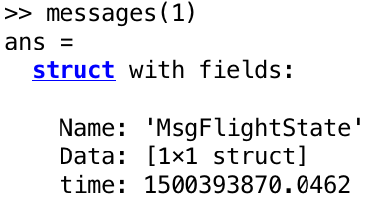
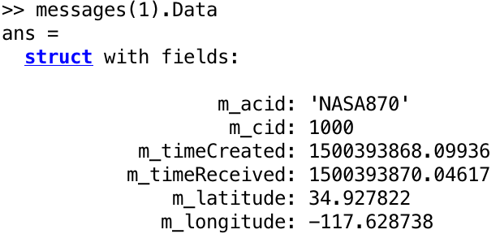
LVC Messaging
messages [struct]: Formatted LVC messages
.Name: Message Type
.Data: Data Payload
.time: Time of Applicability
Notes:
messages [struct]: Formatted LVC messages
.Name: Message Type
.Data: Data Payload
.time: Time of Applicability

Slide 5
LVC Messaging
Mixed LVC Message Types
LVC Messages Structure
.Name
.Data
.time
LVC Log File
.csv
getLVC()

Slide 6
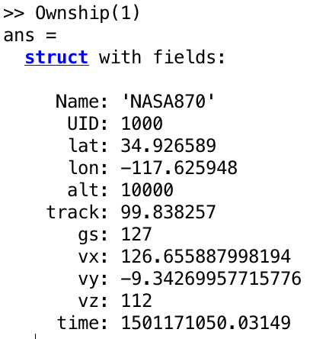
Aircraft States (trafficState)
trafficState [struct]: Aircraft Traffic State
.Name: Aircraft callsign
.UID: Unique Identifier
.lat: latitude
.lon: longitude
.alt: Altitude
.track: Track/heading
.gs: Ground speed
.vx: latitude velocity
.vy: longitude velocity
.vz: climb rate
.time: time UTC

Slide 7

Aircraft States (trafficState)
Ikhana/N3GC GPS Log
.csv
GPS
getTrafficState*()
States of Ownship and Intruder(s)
LVC Messages
.Name
.Data
.Time
genScenarioLVC()
Aircraft trafficState
.Name
.UID…
LVC
Encounter File
.daa
getTrafficStateDAA()
Encounter File

Slide 8
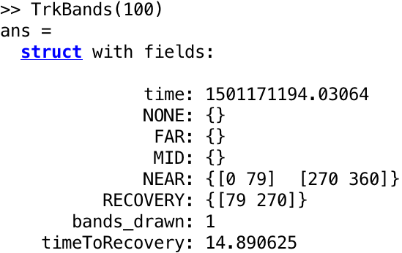
DAIDALUS Bands
*Bands [struct]: DAIDALUS Bands in a given dimension
.time: Timestep
.NONE: NONE level segment
.FAR: FAR segment
.MID: MID segment
.NEAR: NEAR segment
.RECOVERY: RECOVERY segment
.bands_drawn: any(Bands > NONE)
.timeToRecovery: Time to recovery
Notes:
*Bands [struct]: DAIDALUS Bands in a given dimension
.time: Timestep
.NONE: NONE level segment
.FAR: FAR segment
.MID: MID segment
.NEAR: NEAR segment
.RECOVERY: RECOVERY segment
.bands_drawn: Any Bands > NONE?
.timeToRecovery: Time to recovery

Slide 9
DAIDALUS Bands
DAIDALUS Configuration
.txt
States of Ownship and Intruder(s)
Encounter File
.daa
getDAIDBands()
*Bands
.Time
.NONE
.FAR…

Slide 10
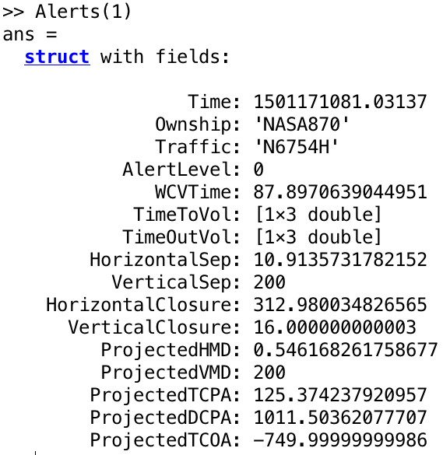
DAIDALUS Alerts
Alerts[struct]: DAIDALUS Alerts for each intruder
Alert Level
Alerting Timelines
Separation Statistics
Projected State Statistics

Slide 11
DAIDALUS Alerts
DAIDALUS Configuration
.txt
States of Ownship and Intruder(s)
Encounter File
.daa
getDAIDAlerts()
Alerts
.Time
.Ownship
.Traffic…
Units
.Time
.Ownship
.Traffic…

Slide 12
Goals
Generate DAIDALUS inputs
Generate DAIDALUS outputs
Visualize guidance and encounter geometry
Plot DAIDALUS outputs for in-depth analysis

Slide 13
Goals
Generate DAIDALUS inputs
Generate DAIDALUS outputs
Visualize guidance and encounter geometry
Plot DAIDALUS outputs for in-depth analysis

Slide 14
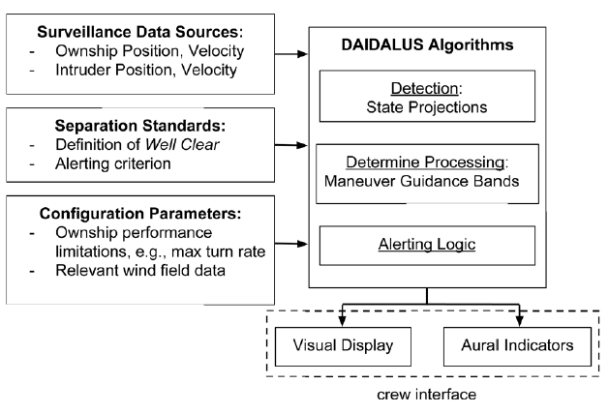
Generate DAIDALUS inputs
DAIDALUS Inputs
Encounter File
.daa
Encounter File
.daa
Aircraft States
ADS-B GPS
DAIDALUS Configuration
.txt

Slide 15
Generate DAIDALUS inputs: Encounter Files
LVC Messages
.Name
.Data
.Time
Aircraft trafficState
.Name
.UID…
genScenarioLVC()
genScenarioTrafficState()
Aircraft trafficState
.Name
.UID…
Encounter File .daa

Slide 16
Goals
Generate DAIDALUS inputs
Generate DAIDALUS outputs
Visualize guidance and encounter geometry
Plot DAIDALUS outputs for in-depth analysis

Slide 17
Generate DAIDALUS Outputs
DAIDALUS Outputs
getDAIDBands()
*Bands
.Time
.NONE
.FAR…
DAIDALUS Inputs
Encounter File
.daa
Alerts
.Time
.Ownship
.Traffic…
DAIDALUS Configuration
.txt
getDAIDAlerts()
Units
.Time
.Ownship
.Traffic…

Slide 18
Goals
Generate DAIDALUS inputs
Generate DAIDALUS outputs
Visualize guidance and encounter geometry
Plot DAIDALUS outputs for in-depth analysis

Slide 19
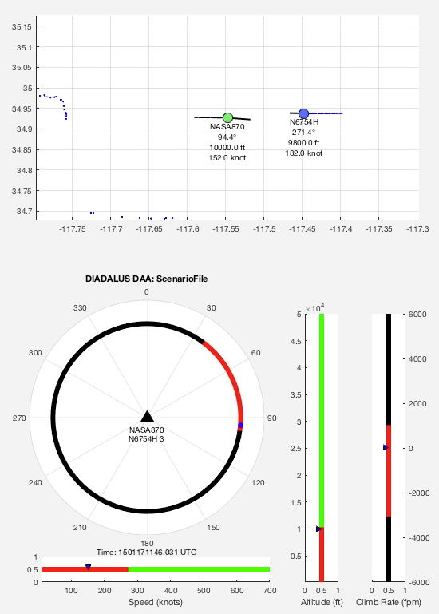
DAIDALUS Guidance Visualization:
drawBandsDAIDALUS()
Bands visualization in all 4 dimensions
2D visualization of encounter
Alert levels per intruder
Produces portable .avi video file

Slide 20
DAIDALUS Guidance Visualization:
drawBandsDAIDALUS()
*Bands
.Time
.NONE
.FAR…
drawBandsDAIDALUS()
Alerts
.Time
.Ownship
.Traffic…
Units
.Time
.Ownship
.Traffic…
Aircraft trafficState
.Name
.UID…
DAIDALUS Configuration
.txt
Encounter.avi

Slide 21
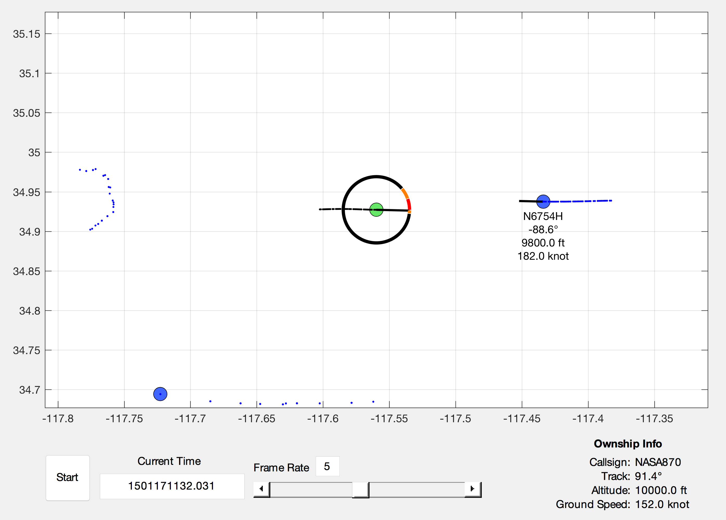
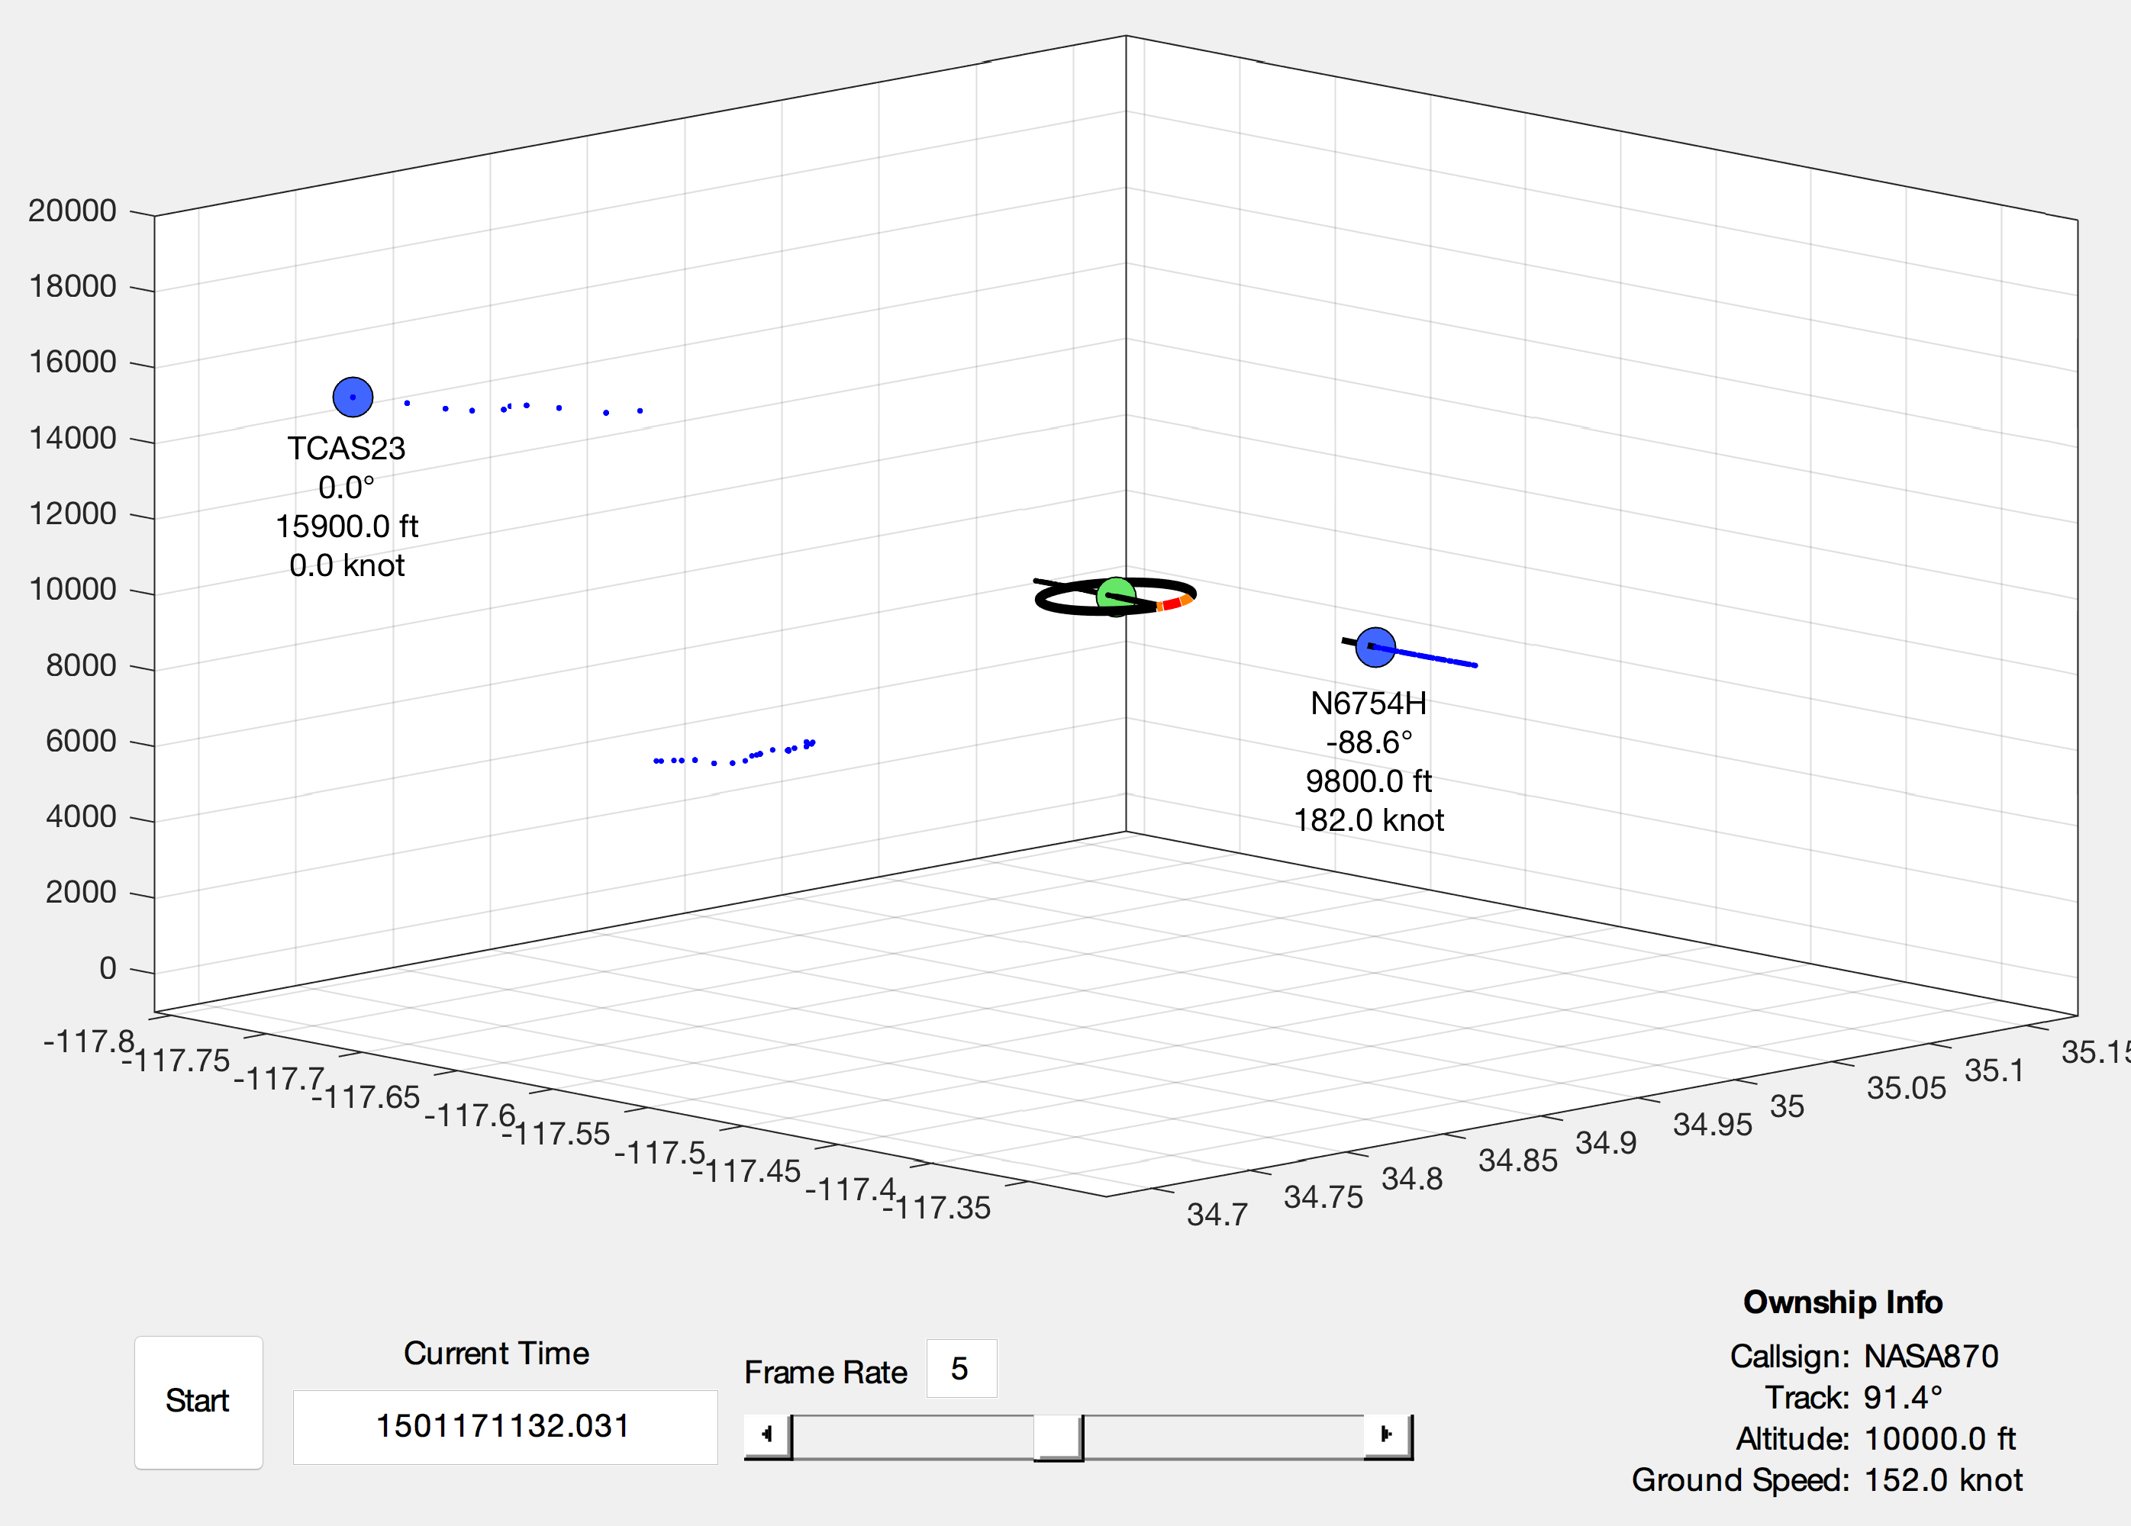
DAIDALUS Guidance Visualization:
kinematicOverview()
Interactive GUI
3D encounter visualization
DAIDALUS Track Guidance

Slide 22
DAIDALUS Guidance Visualization:
kinematicOverview()

Slide 23
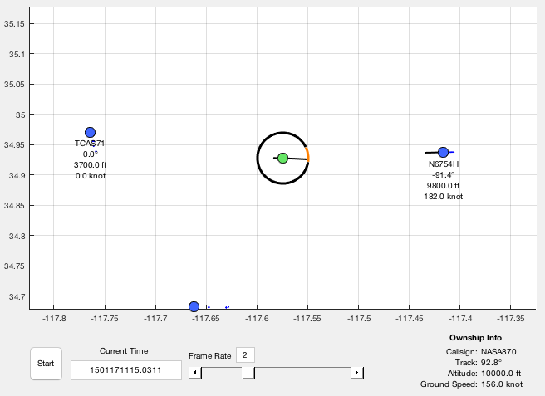
DAIDALUS Guidance Visualization:
kinematicOverview()
DAIDALUS Inputs
Encounter File
.daa
kinematicOverview()
MATLAB GUI
DAIDALUS Configuration
.txt

Slide 24
Goals
Generate DAIDALUS inputs
Generate DAIDALUS outputs
Visualize guidance and encounter geometry
Plot DAIDALUS outputs for in-depth analysis

Slide 25
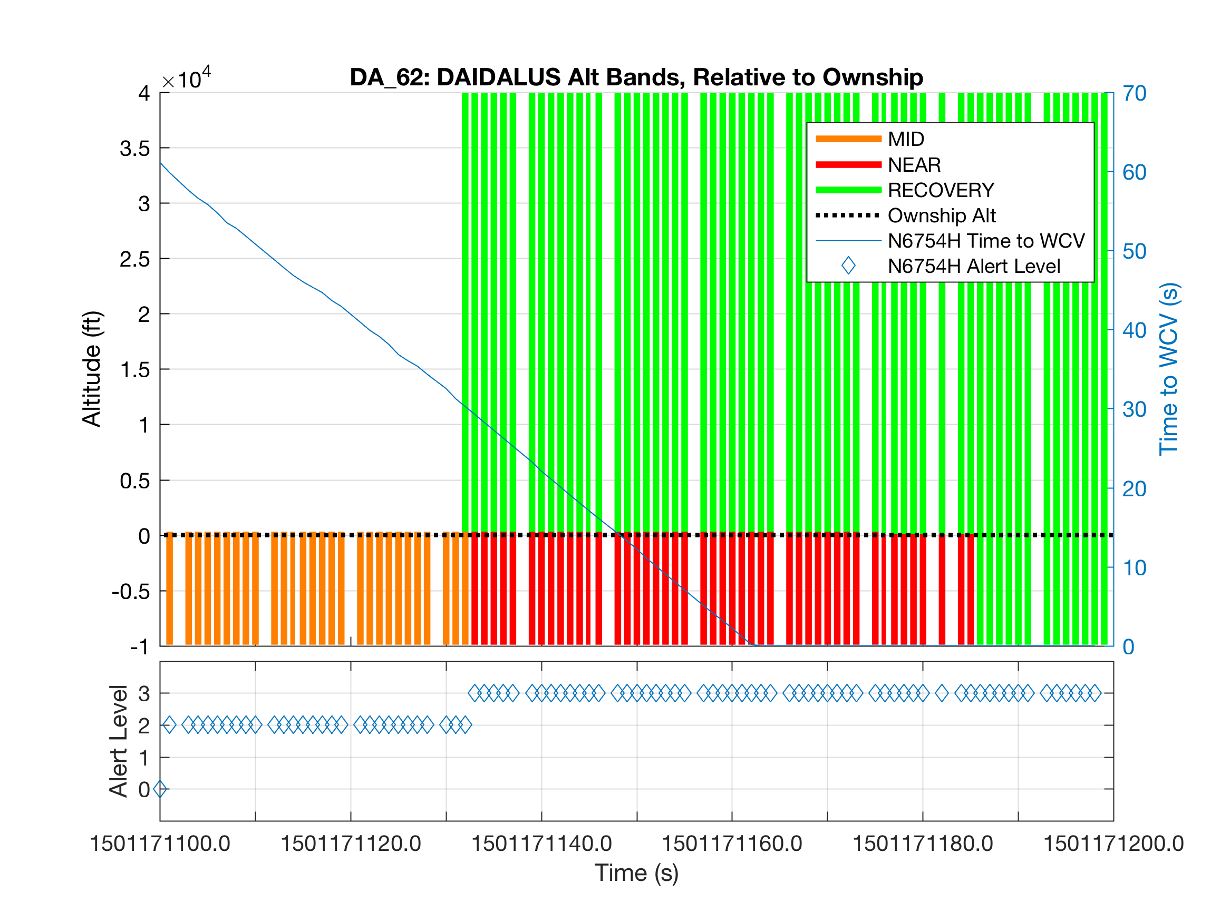
DAIDALUS Plots:
plotBands()
DAIDALUS Bands & Alerting Output vs. Time

Slide 26
DAIDALUS Plots:
plotBands()
In-depth view of guidance throughout an encounter
Works with all 4 dimensions of DAIDALUS guidance
Alerting information overlay

Slide 27
DAIDALUS Plots:
plotBands()
*Bands
.Time
.NONE
.FAR…
plotBands()
Alerts
.Time
.Ownship
.Traffic…
Units
.Time
.Ownship
.Traffic…
Aircraft trafficState
.Name
.UID…
Aircraft Performance Limits
.Alt
.Gs…

Slide 28
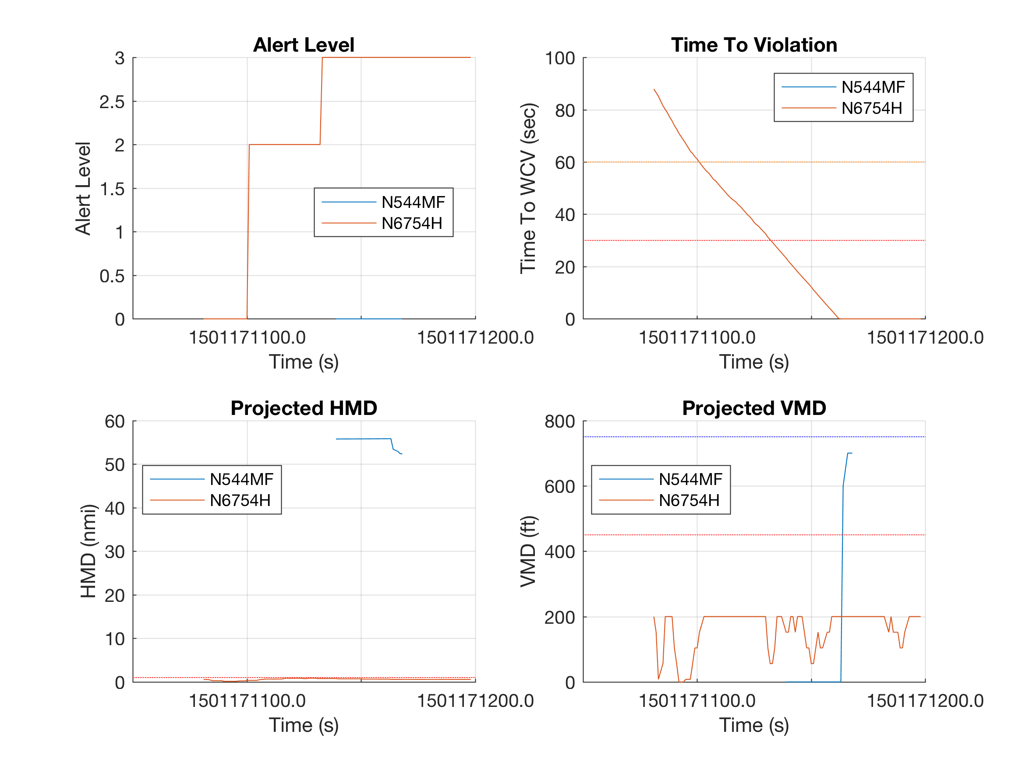
DAIDALUS Plots:
plotWCV()
DAIDALUS Alerting Output vs. Time

Slide 29
DAIDALUS Plots:
plotWCV()
Alerts
.Time
.Ownship
.Traffic…
plotWCV()
Units
.Time
.Ownship
.Traffic…

Slide 30
Quirks & Gotcha’s
MATLAB & Java
Parallel Processing

Slide 31
MATLAB & Java
DAIDALUS.jar must be in MATLAB’s Java Class Path to use functions that call DAIDALUS library
javaaddpath(<‘full path to DAIDALUS.jar’>) Adds jar to MATLAB class path
MATLAB will fail silently to import a jar compiled with a greater Java version than its own
MATLAB version can only be set before launch with EV “MATLAB_JAVA”
#! /bin/bash
export MATLAB_JAVA='/Library/Java/JavaVirtualMachines/jdk1.8.0_144.jdk/Contents/Home/jre’
nohup /Applications/MATLAB_R2017a.app/bin/matlab
disown -h

Slide 32
Parallelized Functions
Some functions can take advantage of more than one processing core to speed up processing time
This requires the Parallel Computing Toolbox
Sessions without this toolbox installed, or without an active parallel pool, will run these functions on a single thread
getLVC() | 1.6x Speedup (4 Cores)
getTrafficStateIkhana() | 2.3x Speedup
getTrafficStateN3GC() | 2.4x Speedup
genScenarioTrafficState() | 3.0x Speedup

Slide 33
BACKUP

Slide 34
Generate DAIDALUS inputs

